Slide 1
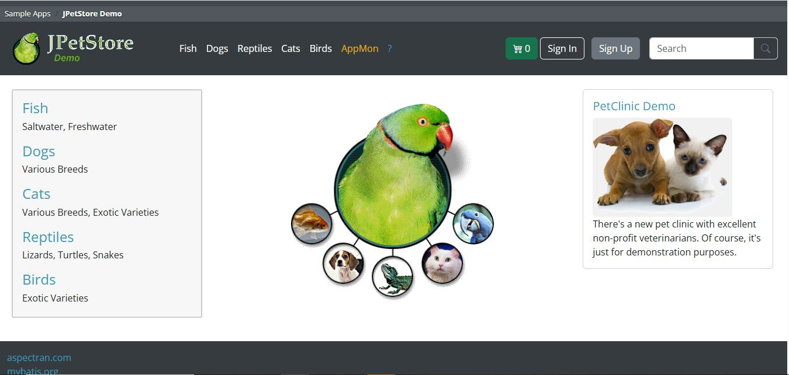
CAPSTONE AUTOMATION TESTING FOR JPETSTORE
A Professional Overview of Our Automation Approach and Results
Presented By:
Mallarapu Koushik
Pulime Venkata Sriiram
Shabber Shaik
Chakkapalli Nagasai
Mohith Uppala
Undavalli Kumar
Sambasivarao Alapati

Slide 2
INTRODUCTION TO THE CAPSTONE PROJECT
Project Goals and Objectives
This capstone project focuses on automation testing for JPetStore, a realistic e-commerce demo application. Our goal is to move beyond manual testing by building a robust, scalable automation framework that improves efficiency, reliability, and overall test coverage.
Key Objectives:
• Improve testing efficiency through automated script execution
• Enhance reliability with consistent, repeatable test runs
• Expand test coverage across all critical JPetStore workflows

Slide 3
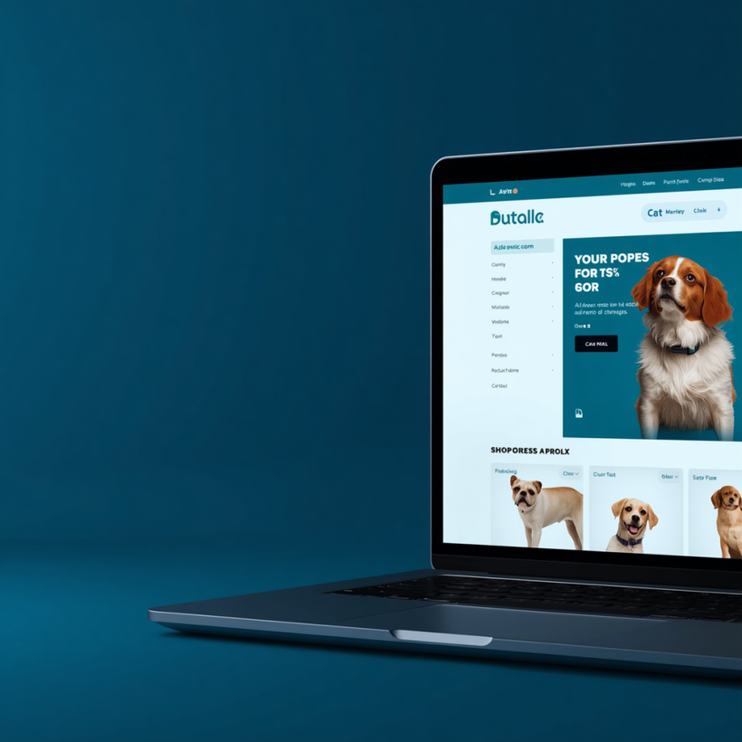
JPETSTORE DEMO APPLICATION AND ITS SIGNIFICANCE
JPetStore is a virtual pet store e-commerce demo application that serves as an ideal platform for practicing and validating automation testing strategies.
Virtual Pet Store E-Commerce Demo
JPetStore simulates a fully functional online pet store with product categories, user accounts, shopping cart, and order workflows — mirroring real-world web applications.
Realistic UI and Workflows
The application provides authentic UI interactions including navigation, form submissions, and dynamic content, making it an excellent candidate for end-to-end automation scenarios.
Significance for Automation Practice
Its open-source nature and well-structured pages allow teams to apply frameworks like Selenium and BDD Cucumber, building reusable and maintainable test suites with measurable coverage.

Slide 4


OUR AUTOMATION JOURNEY
Manual Testing Challenges
Framework Selection
Script Development
Test Runs & Validation
Faced slow, error-prone manual tests with limited coverage and high repetition costs across JPetStore workflows.
Evaluated and adopted Selenium WebDriver with TestNG and Maven for a scalable, maintainable automation stack.
Built modular test scripts using Page Object Model, covering login, search, cart, and checkout scenarios.
Executed full regression runs, captured results via Extent Reports, and iterated to improve stability and coverage.

Slide 5
SELENIUM AUTOMATION FRAMEWORK ARCHITECTURE
SELENIUM WEBDRIVER
PAGE OBJECT MODEL
TESTNG
MAVEN
& BDD CUCUMBER

Slide 6
AUTOMATION TESTING VS MANUAL TESTING
Speed & Repeatability
Automation runs test suites in minutes, executing the same scripts consistently across every build cycle without fatigue or variation.
Accuracy & Scalability
Automated tests eliminate human error, and can scale across browsers, environments, and large data sets simultaneously with ease.
Manual Testing Limitations
Manual testing is time-consuming, prone to human error, and difficult to scale — making it unsustainable for frequent regression cycles.

Slide 7
TEST SCENARIO MODULES COVERED
USER LOGIN & REGISTRATION
PRODUCT SEARCH
SHOPPING CART OPERATIONS
CHECKOUT & ORDER CONFIRMATION

Slide 8

TEST FLOW & EXECUTION PROCESS
Test Initialization & Setup
Script Execution Sequence
Result Capturing
Logging & Reporting
Configure test environment, load browser drivers, set base URL, and initialize TestNG suite before execution begins.
Execute test scripts in defined order using TestNG XML. Page Object methods invoke Selenium WebDriver actions on JPetStore UI.
Capture screenshots on pass/fail, record assertion results, and store test outputs for each executed scenario.
Log detailed execution traces, exceptions, and step-by-step results to console and Extent Report for full traceability.

Slide 9
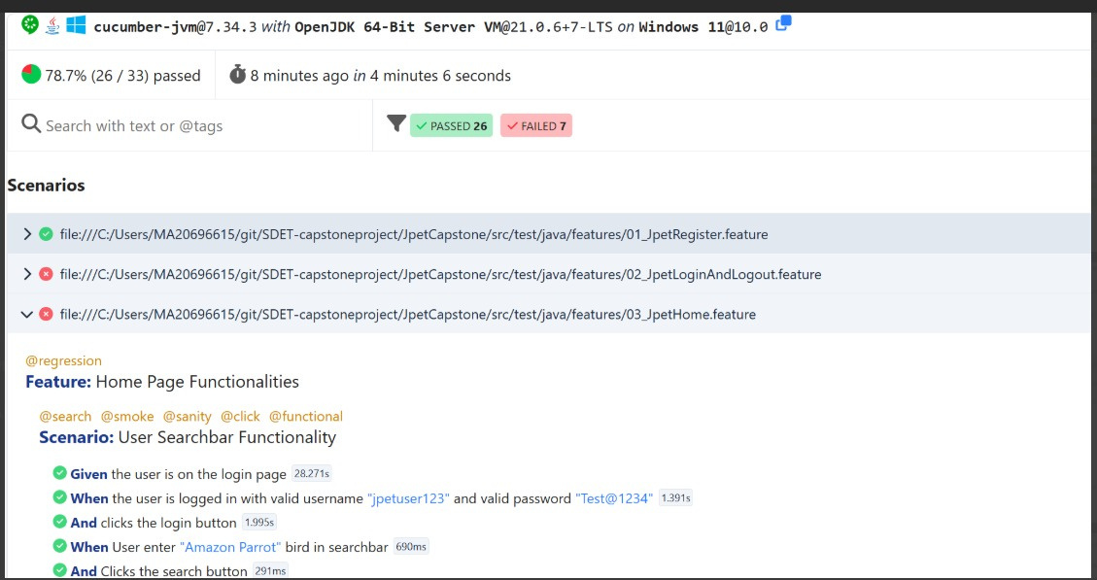
BDD CUCUMBER IMPLEMENTATION
Behavior-driven development bridges communication between testers, developers, and business analysts by expressing test scenarios in natural language Gherkin syntax.
Feature Files in Gherkin Syntax
Scenarios written in plain English using Given/When/Then syntax, making test cases readable by all stakeholders including non-technical team members.
Step Definitions
Java-based step definitions bind Gherkin steps to Selenium WebDriver actions, enabling automated execution of human-readable test scenarios.
Collaboration Benefits
BDD with Cucumber improves test clarity, team collaboration, and coverage transparency across all JPetStore functional modules.

Slide 10


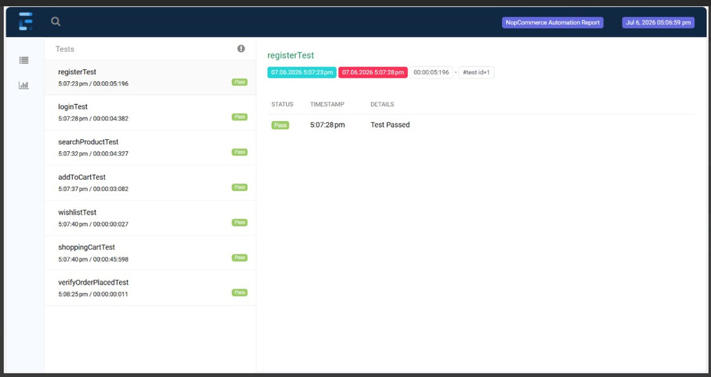
TestNG Framework Integration
Test Grouping & Prioritization
Parameterization & Data-Driven Testing
Organize tests into logical groups and assign priorities to control execution order, ensuring critical test cases run first and results are structured efficiently.
Use @Parameters and DataProvider annotations to run the same test with multiple data sets, increasing coverage without duplicating test scripts.

Slide 11
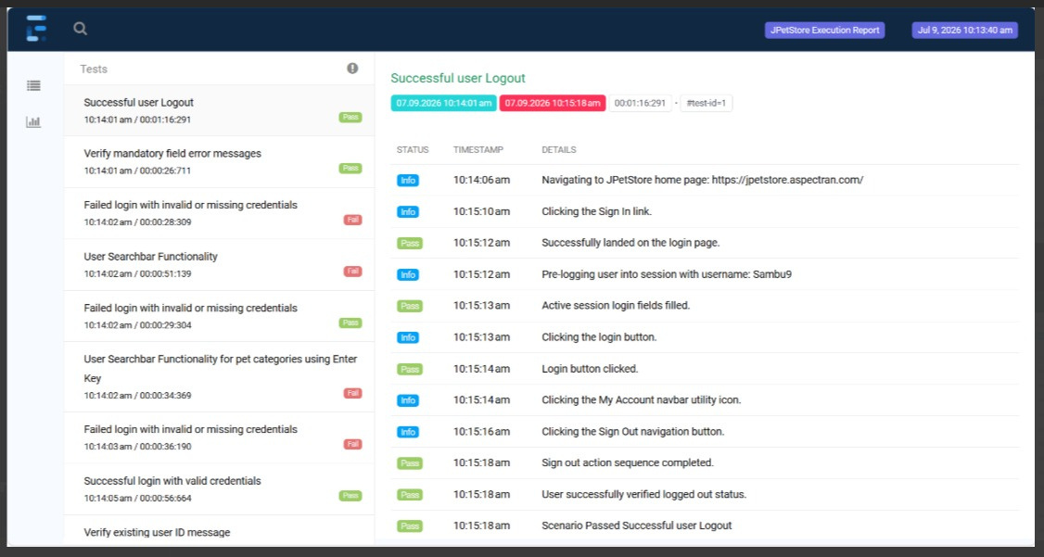
EXTENT REPORTS FOR TEST REPORTING AND ANALYTICS
Extent Reports integrate seamlessly with TestNG and Selenium, generating comprehensive analytics dashboards after each JPetStore test suite execution.
Interactive HTML Reports
Rich, interactive HTML dashboards display detailed test logs, embedded screenshots, and step-by-step execution results for every test run.
Pass, Fail & Skip Visualization
Color-coded charts and summary statistics clearly visualize passed, failed, and skipped test counts, enabling quick identification of failures.
Logs, Screenshots & Analytics
Captured screenshots on failure and detailed execution logs provide actionable insights, supporting faster debugging and continuous quality improvement.

Slide 12

CONCLUSION AND KEY TAKEAWAYS
FASTER & RELIABLE TESTING
Achieved faster, reliable, and repeatable testing for JPetStore through Selenium automation, reducing manual effort and minimizing human error.
ENHANCED COVERAGE WITH BDD
Improved test coverage using a modular framework and BDD approach with Cucumber, enabling better collaboration and clearer test scenarios.
RECOMMENDATIONS & NEXT STEPS
Expand the test suite to cover edge cases, integrate CI/CD pipeline for continuous testing, and adopt parallel execution for faster feedback cycles.

Slide 13
THANK YOU

